Slide 1
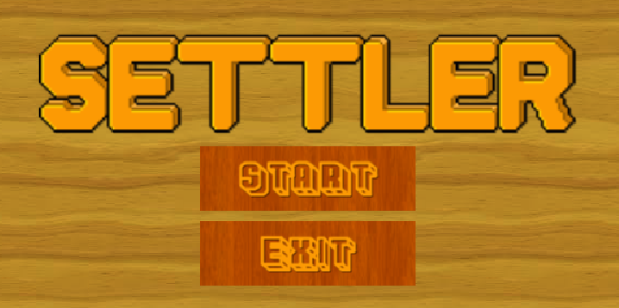

Slide 2
Resource manager/idle game
3 resources:
Gold
Wood
Food
You have population as workforce
They must be feed
Main objective: Reach 50 gold

Slide 3
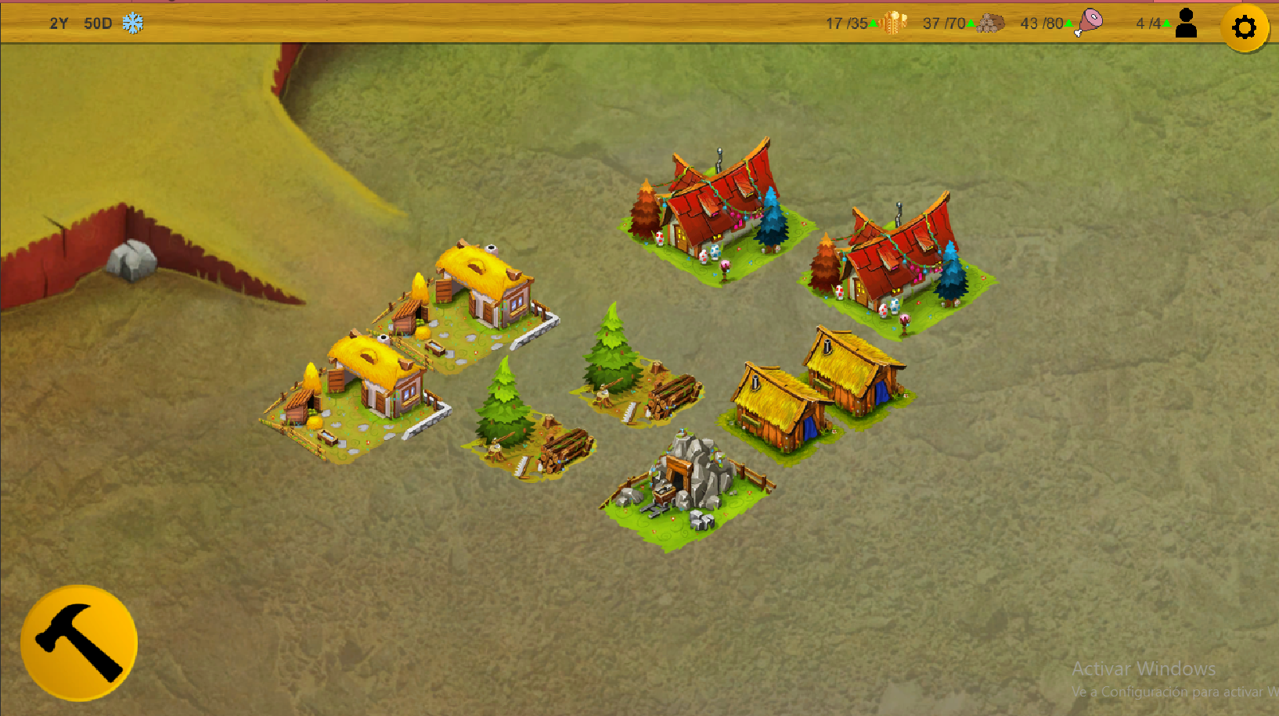

Slide 4
Isometric tilemap

Slide 5
Game manager
Computes gain and loss

Slide 6
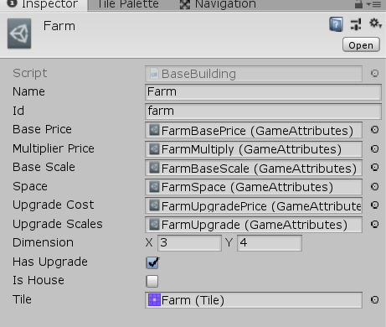
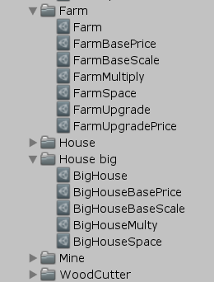
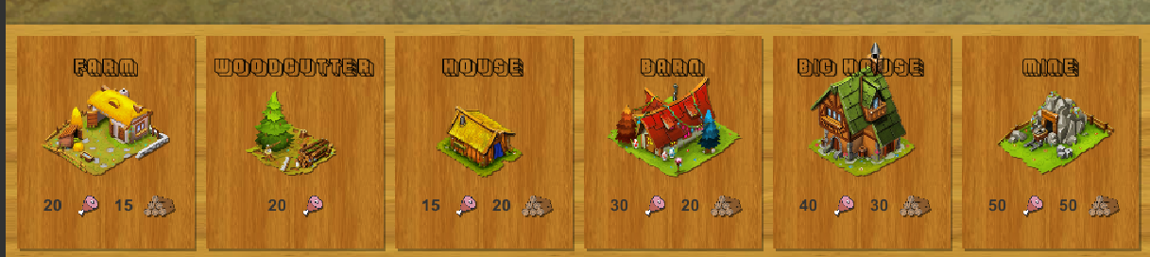
All is ScriptableObject

Slide 7
Timer (seasons production)
Audio manager
Popup system
Dynamic build price

Slide 8
Future work
Improve UI
Visual
Feel and feedback
More buildings and resources
Random events (plage, wars, binary decision)
Add mobile phone support

